Slide 1
Program and Data Structures
Studio 5000
© 2021 John Sefcovic.

Slide 2
Program Structures

Slide 3
Program Structures
Studio 5000
Studio 5000 has Tasks, Programs, and Routines.
Studio 5000
TASKS
PROGRAMS
ROUTINES

Slide 4

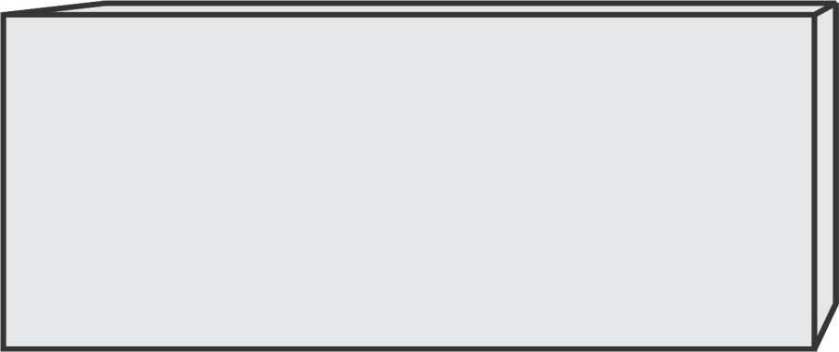
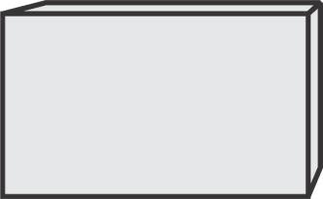
Program Structures
Studio 5000
TASK
Only the Routine contains the logic.
PROGRAM
ROUTINE
The Tasks and Programs organize when the Routines logic is executed.
A Task must contain one Program and a Routine.

Slide 5
Program Structures
Studio 5000
Subroutines or Routines are only scanned when called.
A routine can call another routine.
Routines are used for:
When the same logic is used repetitively.
To reduce over-all scan time of the processor.
To organize program into functional segments.

Slide 6
Program Structures
Studio 5000
TASK
Additional Routines may be added to the Program.
PROGRAM
ROUTINE
A Main Routine is continuously scanned, the other Routines are only scanned when called.

Slide 7
Program Structures
Studio 5000
TASK
Additional Programs with Routines may be added to the Task.
PROGRAM
ROUTINE
Programs are scanned in the order listed in the Controller Organizer.
PROGRAM
ROUTINE

Slide 8
Program Structures
Studio 5000
Programs are used for:
To organize the application into functional areas.
To sequence when logic is to be executed.
To create local data tags.
Additionally, Programs can be disable from executing by the user in Controller Organizer or automatically by logic instructions.
To decrease scan time by running program only when need.
For application diagnostic programs use occasionally.

Slide 9
Program Structures
Studio 5000
TASK
PROGRAM
ROUTINE
Routines cannot be called between Programs.
PROGRAM
ROUTINE

Slide 10
Controller Tag Data Structures

Slide 11


Controller Tag Data Structures
Studio 5000
CONTROLLER TAGS
Controller Tags are the top-level data.
TASK
PROGRAM
ROUTINE
PROGRAM
ROUTINE

Slide 12
Controller Tag Data Structures
Studio 5000
CONTROLLER TAGS
I/O ADDRESSES
assigned to alias
Tag Names
TASK
PROGRAM
ROUTINE
I/O Addresses (example, Local:3:I.Data.0) are at the Controller Tag level.
The I/O Addresses are assigned to Alias Tag Names.
PROGRAM
ROUTINE

Slide 13
Controller Tag Data Structures
Studio 5000
CONTROLLER TAGS
I/O ADDRESSES
assigned to alias
Tag Names
TASK
PROGRAM
ROUTINE
DATA TAGS
Additional Tag Data Types may be assigned at as Controller Tags, such as, I/O, Boolean, Timer, Counter, Integer, or Real.
PROGRAM
ROUTINE

Slide 14
Controller Tag Data Structures
Studio 5000
CONTROLLER TAGS
I/O ADDRESSES
assigned to alias
Tag Names
TASK
PROGRAM
ROUTINE
DATA TAGS
All Tags assigned at Controller Tag level are Global and can be accessed by all Program Routines.
PROGRAM
ROUTINE

Slide 15
Program Tag Data Structures

Slide 16

Program Tag Data Structures
Studio 5000
CONTROLLER TAGS
I/O ADDRESSES
assigned to alias
Tag Names
TASK
PROGRAM
ROUTINE
DATA TAGS
PROGRAM
TAGS
Program Tag are Local Tags defined at the Program level and can be accessed by the Program’s Routines.
PROGRAM
ROUTINE
PROGRAM
TAGS

Slide 17
Program Tag Data Structures
RSLogix 5000
CONTROLLER TAGS
I/O ADDRESSES
assigned to alias
Tag Names
TASK
PROGRAM
ROUTINE
DATA TAGS
PROGRAM
TAGS
Additional Tag Data Types may be assigned at as Program Tags, such as, I/O, Boolean, Timer, Counter, Integer, or Real.
PROGRAM
ROUTINE
PROGRAM
TAGS

Slide 18
Program Tag Data Structures
Studio 5000
CONTROLLER TAGS
I/O ADDRESSES
assigned to alias
Tag Names
TASK
PROGRAM
ROUTINE
DATA TAGS
PROGRAM
TAGS
The data Program Tags can only be used by the Routines in the Programs where the Tags were defined.
PROGRAM
ROUTINE
Tags cannot be shared between Programs.
PROGRAM
TAGS

Slide 19
Routines Structures

Slide 20



Routines Structures
Studio 5000
The Main Routine is the continuously scanned program.
Routines are called by the Main Routine.
MAIN
ROUTINE
ROUTINE1
When the scan of the Routine is complete, program execution returns to the calling Routine. In this example the Main Routine.
Program execution, scanning, goes to
the called Routine.
ROUTINE2
ROUTINE3

Slide 21

Routines Structures
Studio 5000
Routines are called by the Main Routine.
MAIN
ROUTINE
ROUTINE1
A Routine may call another Routine.
Program execution, scanning, goes to
the called Routine.
ROUTINE2
ROUTINE4
When the scan of the Routine is complete, the program execution returns to the calling Routine.
ROUTINE3

Slide 22
Routines Instructions

Slide 23
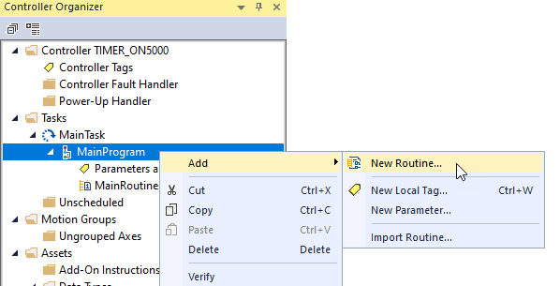
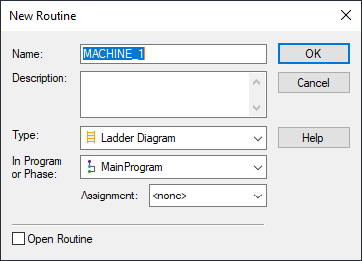
Routines Instructions
Studio 5000
To add a Routine, in the Controller Organizer right click on the Program, select Add then New Routine.
Enter the Name for the Routine and select the OK button.

Slide 24
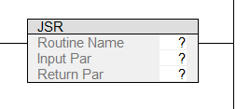

Routines Instructions
Studio 5000
JUMP TO SUBROUTINE
The JSR is an output which on a True rung calls the routine to be scanned or executed.
The JSR instruction is on the Program Control tab.
Use the Scroll Right-Left Arrows to select the tabs.

Slide 25
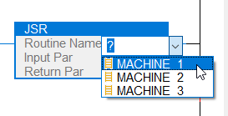
Routines Instructions
Studio 5000
The Routine must be created before using the JSR instruction to call the routine.
To add the called routine, double left click on the question mark for Routine Name.
Left click on the down arrow and select the routine’s name.

Slide 26
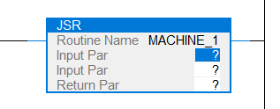
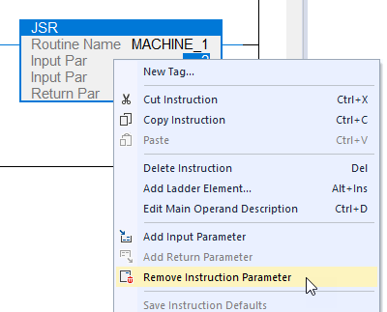

Routines Instructions
Studio 5000
The instruction will have the optional Input Par and Return Par (parameters).
Right click and select Remove Instruction Parameter.
Repeat to remove the remaining parameters.

Slide 27


Routines Instructions
Studio 5000
SUBROUTINE
Defines Tag for receiving Input Parameters
The SBR must be the first instruction on the first rung of the routine.
The SBR instruction is only needed when a Input Par is defined in the JSR.
RETURN
Defines Tag for sending Output Parameters
The RET is usually on the last rung of the routine file. May be used on a conditional rung to terminate the routine’s execution.
The RET instruction is only needed when a Ret Par is defined in the JSR.

